Slide 1
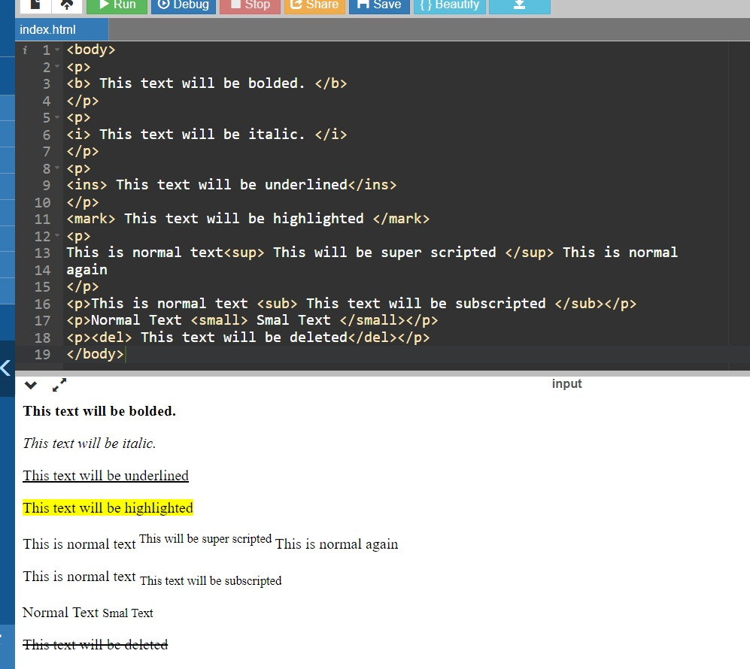
1) Build a siple webpage that displays text as shown in the below image.

Slide 2
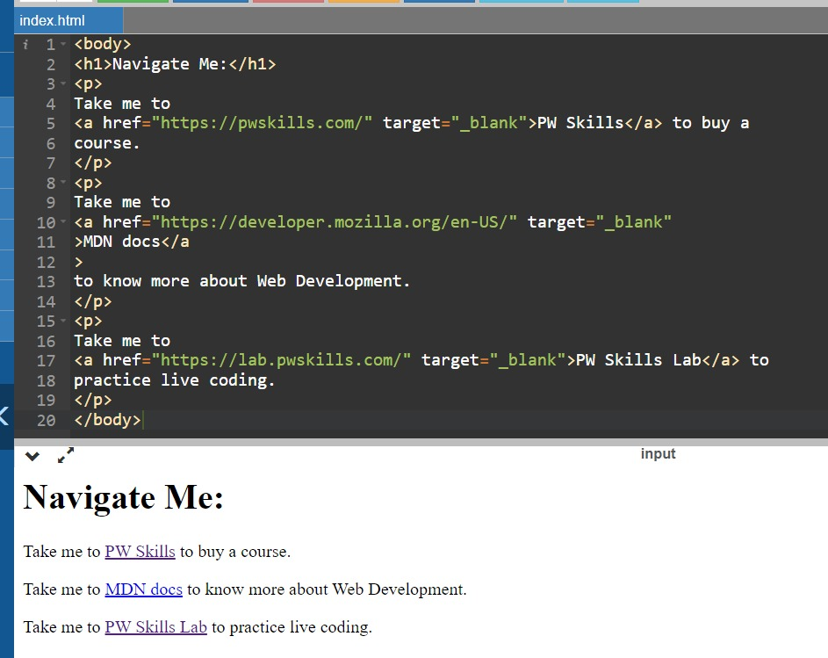
2) Build a simple webpage that helps users navigate different web development-related websites.

Slide 3
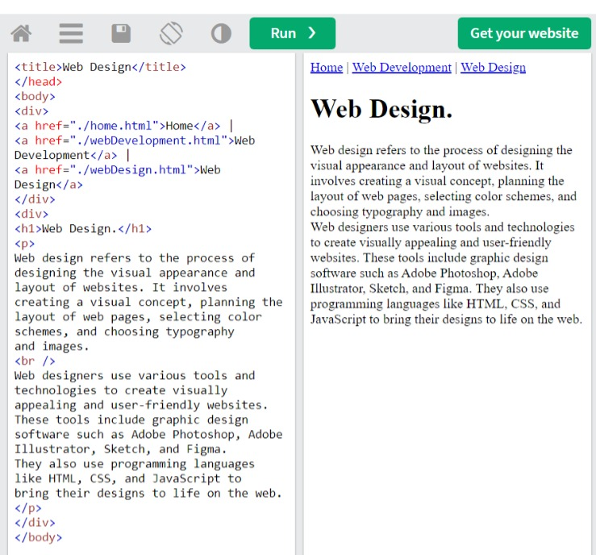
3) Build a simple blog web page with 3 pages home, web development, and web design. Each page must
contain hyperlinks to other pages in the top, a heading of the page topic and a paragraph of information.
For the home page you can add some information about yourself.
Home page

Slide 4
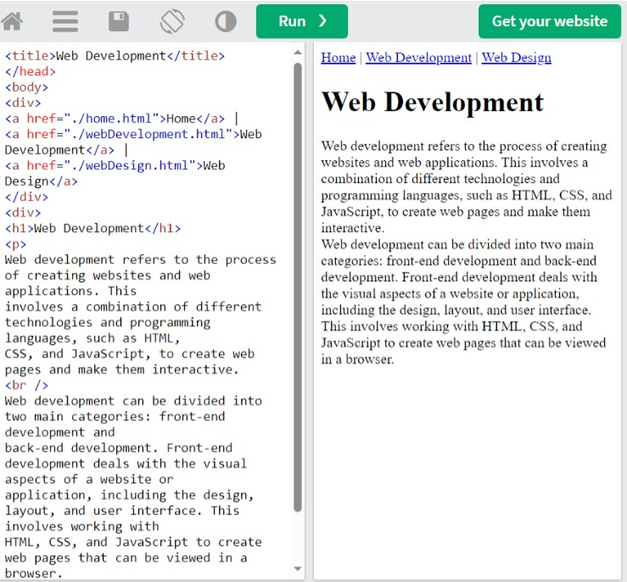
Web development

Slide 5
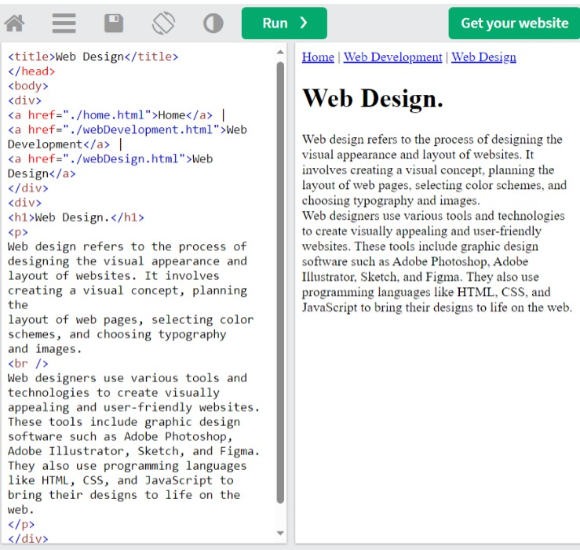
Web design

Slide 6
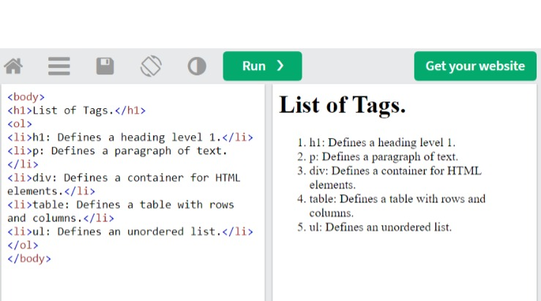
4) Create an ordered list of HTML tags. Each list item must include the tag name and some information about
the tag.

Slide 7
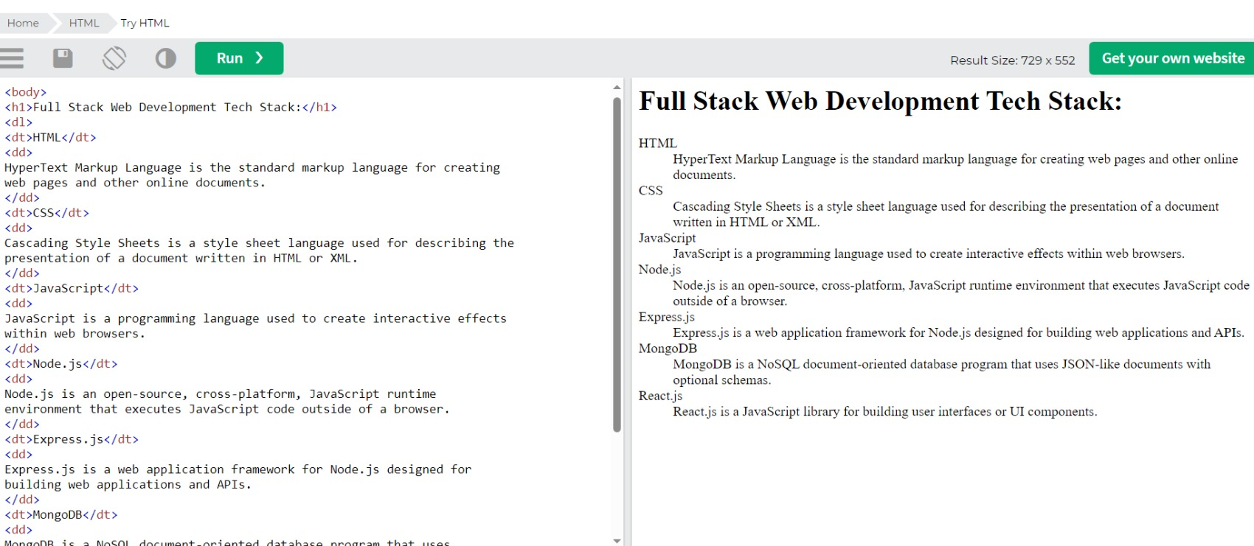
5) create a description list of full stack web deKelopment tech stack, using the <dl> tag. Each term should be
a tech stack name and each descriptio# should be a brief explanation of what the tech stack is used for.

Slide 8
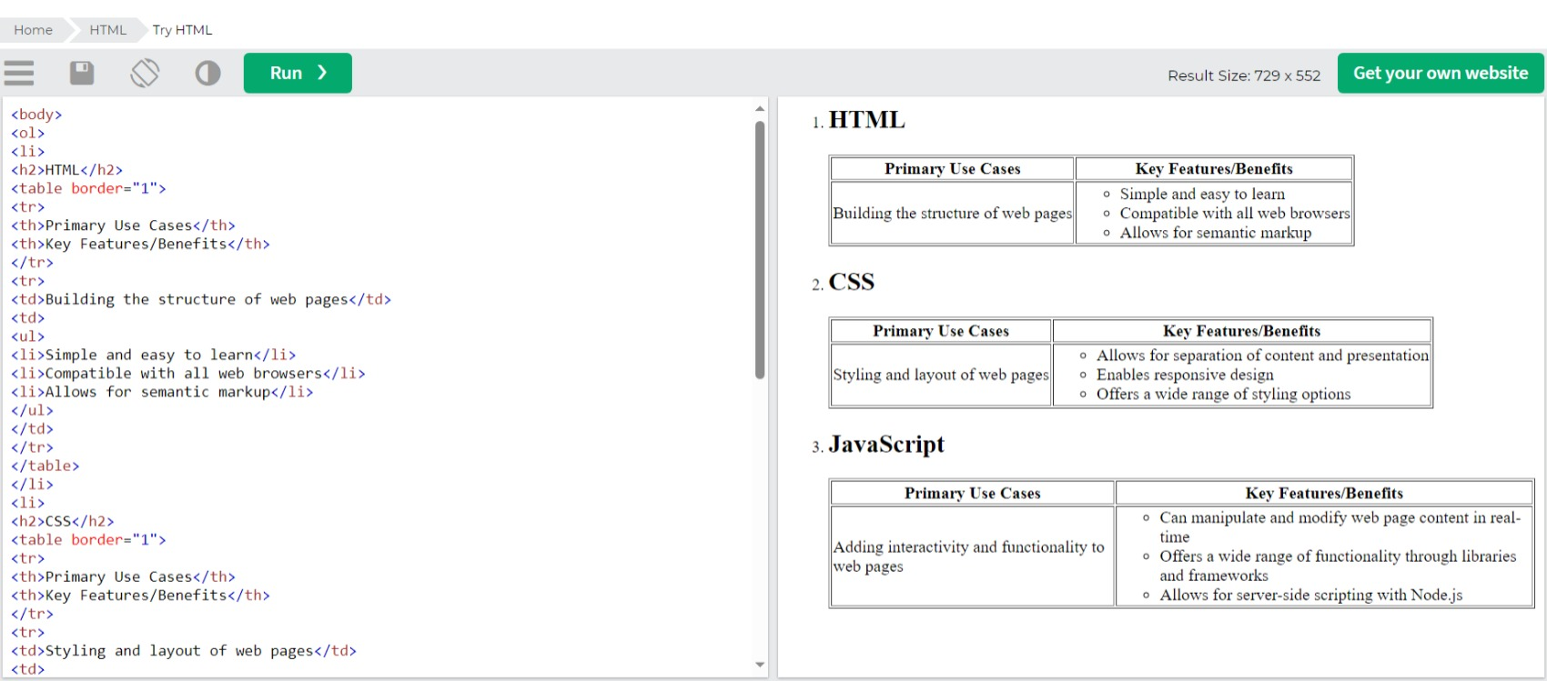
6) Create an ordered list fo the full stack web development tech stack html,css,js.For each tech stack, create a table that lists the tech stack name, its primary use cases, and some key features or benefits

Slide 9
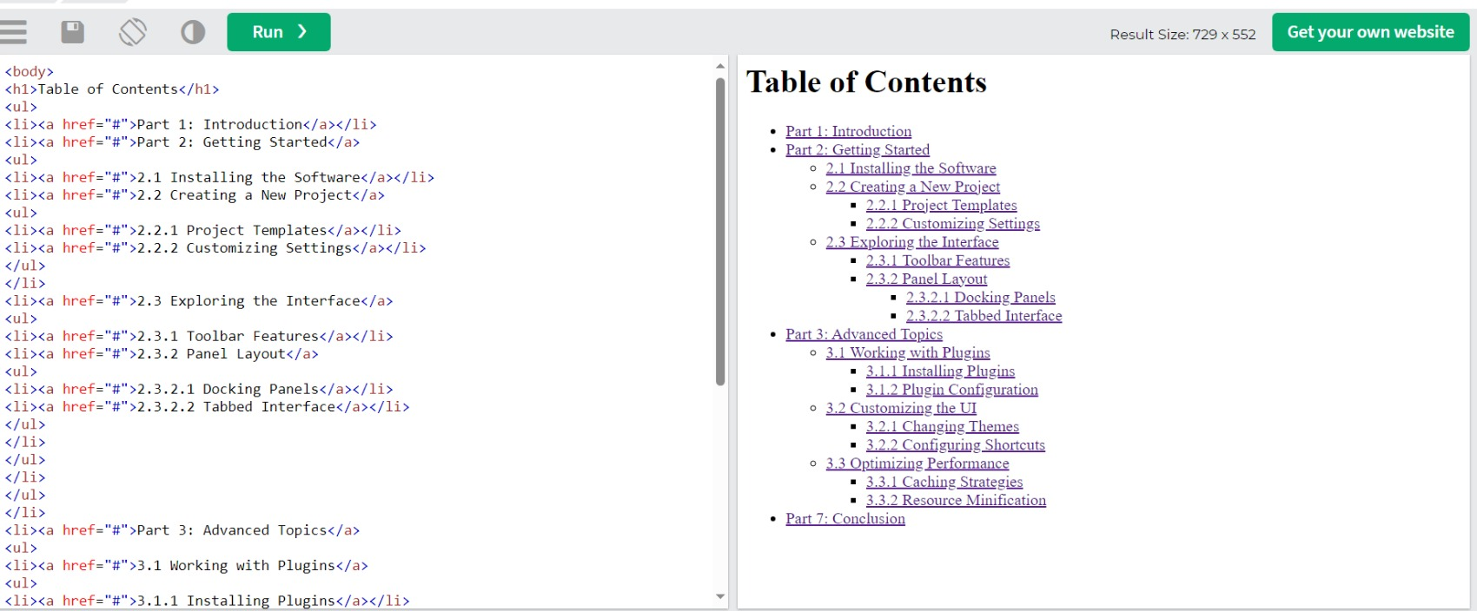
7) Build a complex nested list structure representing a multi-level table of contents. Use unordered lists
(<ul>) and list items (<li>) with inline-block styling to create a structured layout. Apply formatting tags to
enhance the presentation of list items.

Slide 10
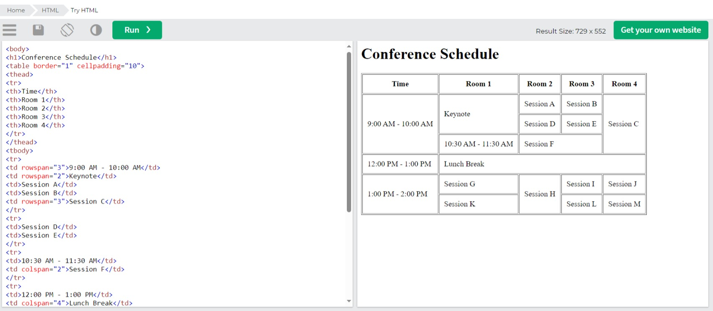
8) Build a complex nested list structure representing a multi-level table of contents. Use unordered lists
(<ul>) an( list items (<li>) with inline-block styling to create a structured layout. Apply formatting tags to
enhance the presentation of list items.

